Slide 1

Noida Institute of Engineering and Technology, Greater Noida
Technical Communication
AASL 0401
Unit: 2
Technical Writing - I
Department of English
B. Tech.
Semester-IV

Slide 2
CO-PO Mapping
Course Name: Professional Communication (AASL 0101)
CO | PO-1 | PO-2 | PO-3 | PO-4 | PO-5 | PO-6 | PO-7 | PO-8 | PO-9 | PO-10 | PO-11 | PO-12
CO1 | 2 | 2 | 2 | 2 |  | 1 | 1 | 1 | 2 | 3 | 2 | 2
CO2 | 1 | 1 | 1 | 1 | - | - | - | 1 | 2 | 3 | 1 | 2
CO3 | 2 | 1 | - | 1 | - | 1 | 1 | 0 | 2 | 3 | 2 | 2
CO4 | 1 | - | - | 2 | - | - | - | - | 3 | 3 | 1 | 3
CO5 | 3 | 1 | - | 1 | - | 1 | - | 3 | 3 | 3 | 1 | 3
Mean | 1.8 | 1.25 | 1.5 | 1.4 | 0 | 1 | 1 | 1.25 | 2.4 | 3 | 1.4 | 2.4

Slide 3
Course Outcomes
Course Name: Technical Communication
The students will be able to:
CO1 | Comprehend the fundamental principles of technical communication with special reference to reading.
CO2 | Write various kinds of professional correspondence.
CO3 | Recognise and produce different kinds of technical documents.
CO4 | Apply effective speaking skills to communicate at the workplace.
CO5 | Demonstrate their understanding of various ethical concerns in written communication.

Slide 4
Prerequisites/ Recap
Basic knowledge of English language
Fundamentals of Technical communication

Slide 5
Unit Contents
UNIT-II 5 Hours
Characteristics of technical writing, technical vocabulary, etymology
Business letters and e-mails - types, format , style and language
Notices , Agenda, and Minutes
Job Application, CV, and Resume

Slide 6
Unit Objective
The objective of the Unit is to familiarize the students with the basic nuances of Writing Skills
The Unit provides a foundation in E-mail writing, Notices, Resume, etc.

Slide 7
Topic Objective/ Topic Outcome
Students will be able to understand Technical vocabulary and their etymology
This topic will create interest in technical words and its usage

Slide 8
Noida Institute of Engineering and Technology, Greater Noida
Technical Communication
AASL 0401
Unit: 2, Topic: 1
Technical Writing: Technical vocabulary, Etymology
Department of English
B.Tech.
Semester - IV

Slide 9
Prerequisite and Recap
Prerequisite
Basic Understanding of the Language and nuances of Communication
Recap
Writing Skills

Slide 10
Introduction
Technical Writing :
It can be defined as the practice of articulating any product or service in the form of a document where processes are defined such as software manuals or instructional materials.
As an engineer your job will be to apprise your readers of the complex functions of appliance/machine in a way that they can understand and apply, even if they do not have prior knowledge of the topic.

Slide 11
Technical Writing Skills
Qualities associated with Technical Writing:
Needs to be written precisely so that it can be understood by users or target audience.
To understand the target audience so that your document or technical content may connect with them quickly.
Write stepwise guidance about how to perform something or some process.

Slide 12

Technical Writing Skills

Slide 13
Characteristics of Technical Writing
Clear: Technical writing requires concise sentences that leave no room for misunderstanding.
Precise: The language must be describing objects and procedures in an exact manner.
Straightforward: It requires information in a way that is direct and straight to the point without the use of literary devices.
Easily understandable: Avoid words that people may not understand.
Structured: Technical writing is very structured. The audience needs to be able to rely on technical writing for step-by-step instructions.

Slide 14
Characteristics of Technical Writing cont..
Denotative meanings: This type of writing relies on the denotative meanings of words to ensure that misunderstanding do not occur due to differing interpretations based on connotation.
Detailed: Technical writing is very detailed and informative, leaving nothing to the imagination. The best example of technical writing is a Textbook.
Problem-solving focus: Readers use these documents to learn how to perform certain tasks or gain technical information, so they should be easy to follow and organized in a way that’s easy to refer to as questions come up.

Slide 15
Examples of Technical Writing
User manuals
Lab reports
Driving directions
Medical prescriptions, etc.

Slide 16
Technical Vocabulary
Fabrication | The process of inventing and producing something
Friction | The resistance of a surface when it moves over another surface
Generator | A machine that converts mechanical energy into its electric equivalent
Hydraulic | A liquid moving in limited space under pressure
Intersection | A point where two or more things cross each other
Machine | A device that uses power to put force and control its movement to perform an action
Technical vocabulary is composed of words with a specialized meaning used usually in one specific subject.

Slide 17
Examples of Technical Vocabulary
Technical Terms | Meaning
Analysis | A detailed examination of something
Automation | The use of automated equipment instead of manpower
Calculation | A computing determination of an amount
Consultation | Seeking advice from an expert
Depth | The measure of the deepness of something

Slide 18
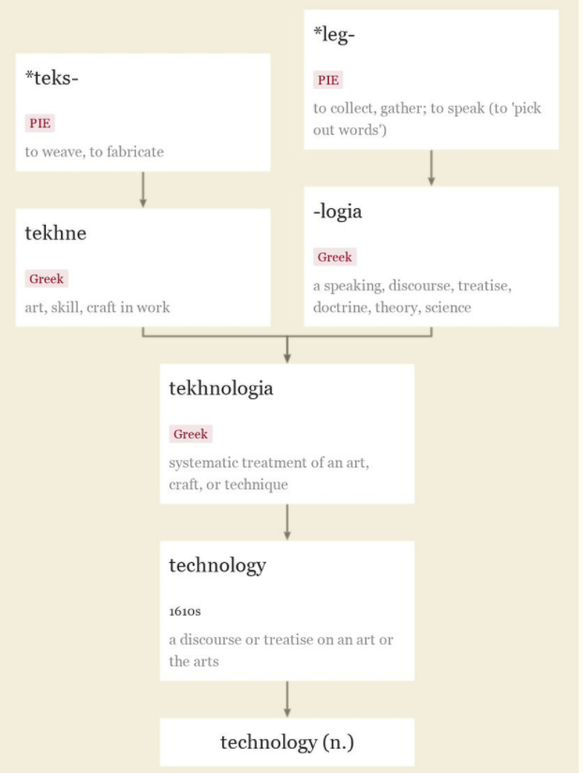
Etymology
The study of the origin of words and the way in which their meanings have changed throughout history.

Slide 19
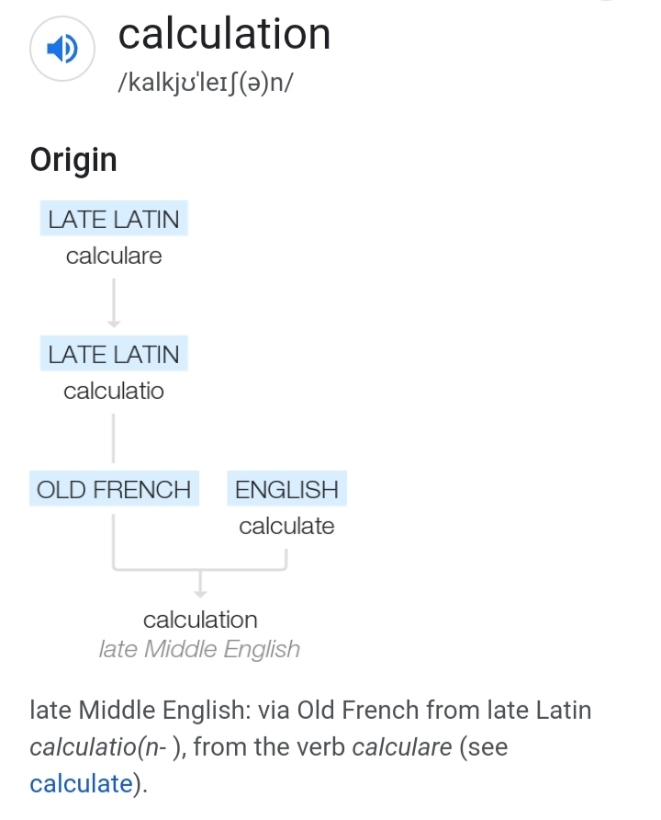
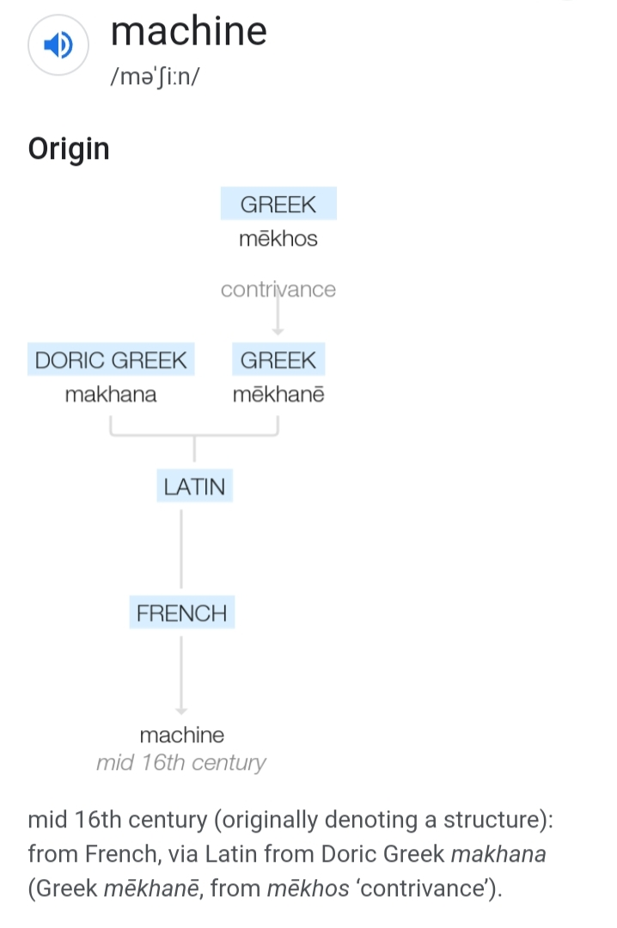
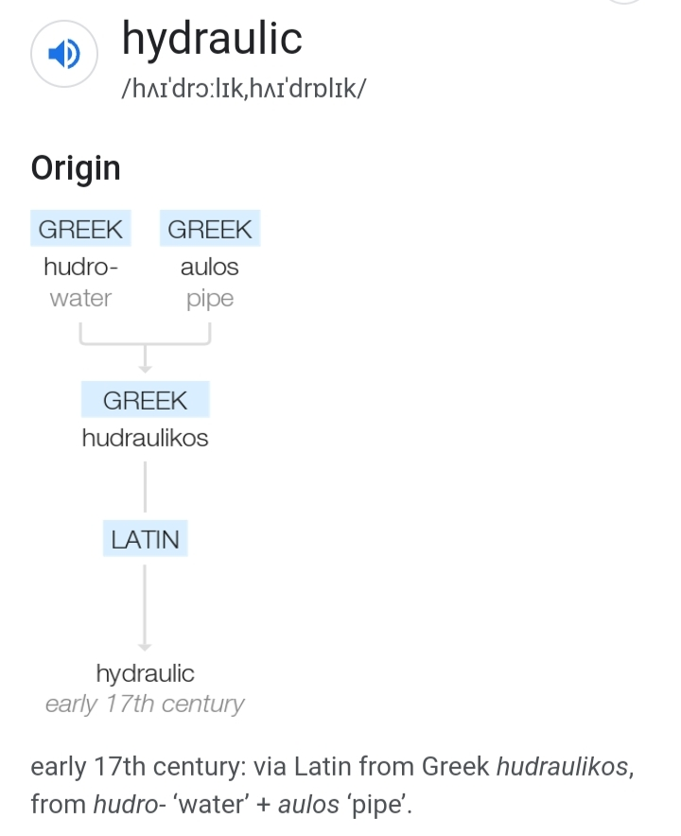
Examples of Etymology of Technical words

Slide 20
Daily Quiz
What is a technical word?
A word that has specific meaning in science, math, or another subject area
A word that is very difficult to figure out because it is long and has many syllables
A word that has many meanings
A word that is not found in a ,dictionary so you must figure out what it means
2. Pardon given to political prisoners
Bail
Parole
Amnesty
Emancipation
3. To cut off an organ by surgery
Operation
Amputate
Incision
Pathology

Slide 21
Daily Quiz(Answers)
What is a technical word?
A word that has specific meaning in science, math, or another subject area
A word that is very difficult to figure out because it is long and has many syllables
A word that has many meanings
A word that is not found in dictionary so you have to figure out what it means
2. Pardon given to political prisoners
Bail
Parole
Amnesty
Emancipation
3. To cut off an organ by surgery
Operation
Amputate
Incision
Pathology

Slide 22
Weekly Assignments
What is the basic difference between connotative meaning and denotative meaning?
2. Why do we need to use denotative words in technical writings?

Slide 23
Topic Links
Technical Vocabulary (Technical English) - YouTube
Learn Technology Vocabulary for Mobile Phone & Computers - English Lessons to speak fluent English – YouTube
Business English Vocabulary : VV 47 – Manufacturing & Production Process (1) | English Vocabulary - YouTube

Slide 24
MCQs
1. A state of having no money to pay off debts
Bankruptcy
Solvent
Dilapidated
Auction
2. A formal accusation against a person for a crime
a) Indictment
b) Acquittal
c) Detain
d) Custody
3.The study of artifacts from ancient societies
a)Archeology
b)Gerontology
c)Paleontology
d)Eugenics

Slide 25
MCQs (Answers)
1. A state of having no money to pay off debts
Bankruptcy
Solvent
Dilapidated
Auction
2. A formal accusation against a person for a crime
a) Indictment
b) Acquittal
c) Detain
d) custody
3.The study of artifacts from ancient societies
a) Archeology
b) Gerontology
c)Paleontology
d)Eugenics

Slide 26
Old Questions
What are the techniques of technical writing? Explain briefly. (2018-19)
What is Technical style? How does choice of words determine the style of technical writing? (2018-19)
Effective writing is essential for business success, justify the statement. (2019-20)

Slide 27
Expected Questions
1.Prepare a Technical script either for your newly invented Hydro-electric car or newly developed Software that can measure people’s arrogance and hatred.
2. Write the etymology of the following Technical words : Computer, Engineering, Mechanical, Cache, Rocket.

Slide 28
Recap
Qualities associated with Technical Writing
Characteristics of Technical Writing
Technical vocabulary
Etymology of Technical words

Slide 29
Noida Institute of Engineering and Technology, Greater Noida
Technical Communication
AASL 0401
Unit: 2, Topic-2
Business letter & E-mail writing
Department of English
B. Tech.
Semester-IV

Slide 30

Prerequisite/ Recap
Recap
-Technical vocabulary
- Etymology of Technical
words
Prerequisite
- Basic knowledge of English language

Slide 31
Topic Mapping With Course Outcome
Topic-2
Students will learn to write Business letters and E-mails

Slide 32
Business Letter Vs. E-Mail
Letter is a hard copy, and the e-mail is a soft copy – an electronic message.
After you compose a business letter, you print it, seal it in an envelope, affix postage and use a service such as Indian Postal Service or an overnight delivery company to send the letter to the recipient. A business e-mail, on the other hand, also is composed usually using a computer or electronic means, but it is electronically dispatched to the recipient in a matter of just a few seconds.
The commonly used format for business letters and e-mails is block style.

Slide 33
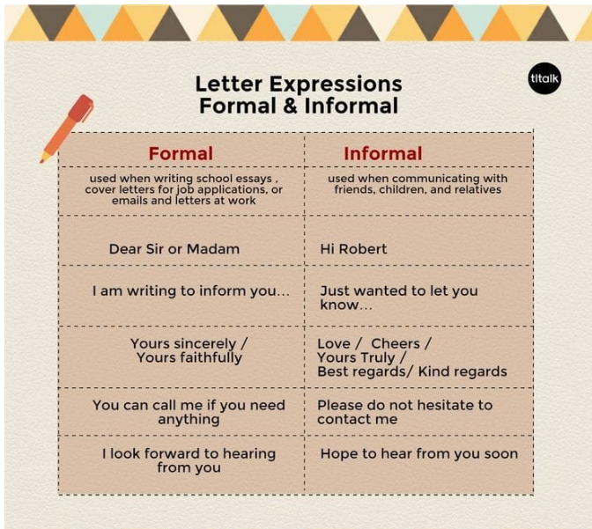
Expressions usage in a letter

Slide 34
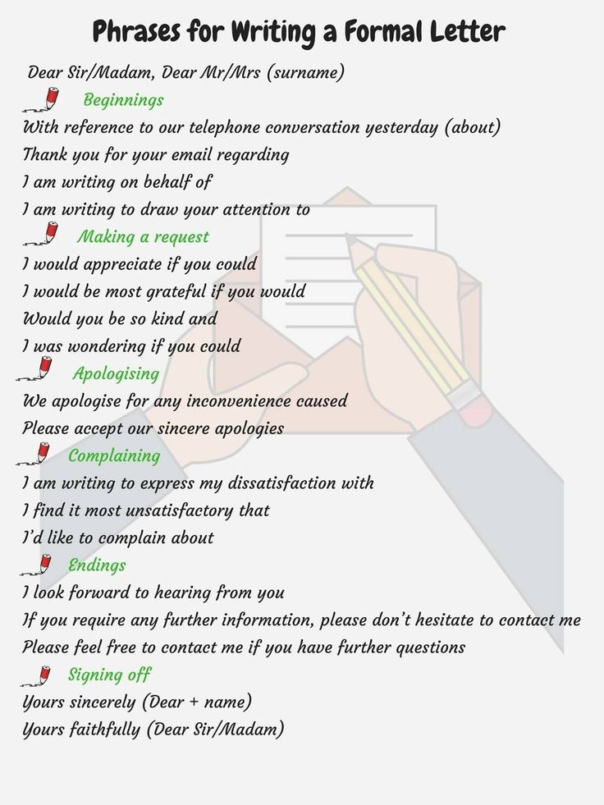
More expressions

Slide 35
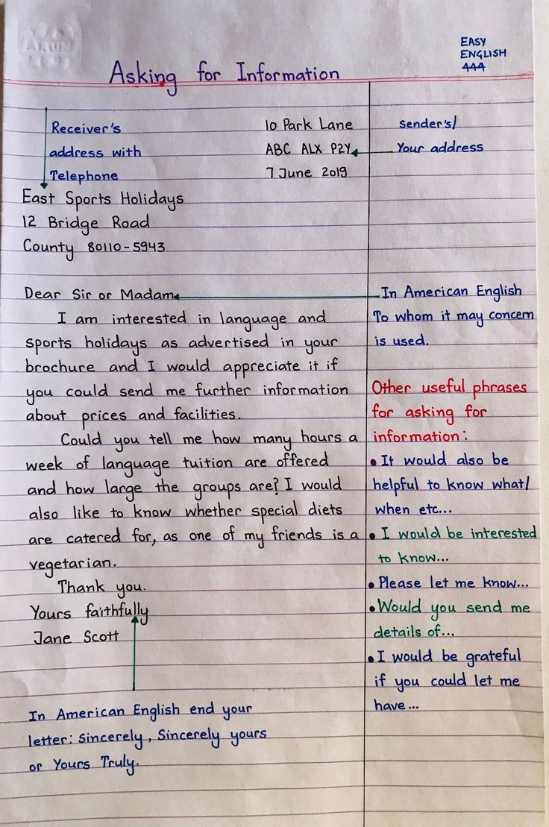
Structure of a business letter

Slide 36
Example of A Business Letter
John Bravo Sender’s address
ABC Education Inc.
1234 – 123 Street
New York, NY 01218
April 21, 2022
Sarah Geenie Receiver’s address
XYZ Company Inc.
6789 – 789 Street
New York, NY 04851
Sub. : Updated Billing Frequency Reason
Dear Ms. Geenie,
I am writing to inform you of our new pricing model effective February 1, 2023. On the first of February, we will be switching from an annual billing cycle to a quarterly billing cycle and this letter contains important information that may impact your organization.
After conducting extensive research and receiving feedback from our customers, we have determined that most customers strongly prefer a quarterly billing cycle rather than an annual one. In order to best suit your needs, we have decided to offer this benefit, which will take effect on February 1, 2023.
This letter is simply to notify you of the upcoming changes, and no immediate action is required from you at this time. We thank you for your continued business.
Sincerely,
John Bravo

Slide 37
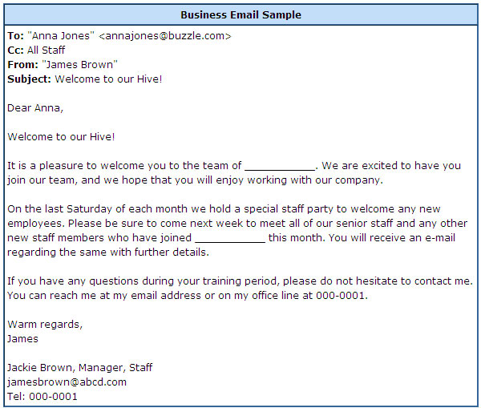
E-Mail

Slide 38
Weekly Assignment
What are the characteristics of Technical Writing?
As a Purchase Officer of a company, write a complaint letter to Masyc Projects Pvt. Ltd., M.I.E. Bahadurgarh, Haryana, pointing out the damage which was discovered after checking the consignment containing Laptops sent to you by the supplier. Invent the necessary details.
Should e-mail replace the communication forms such as letters? Explain your answer.

Slide 39
Topic Links
"Introduction to Business Letters/ Formal Letters"
https://www.youtube.com/watch?v=xdg8Mnr0tus
How to write professional emails in English
https://www.youtube.com/watch?v=3Tu1jN65slw

Slide 40
MCQ s
1.Sending an e-mail is similar to
Picturing an event
Narrating a story
Writing a letter
Creating a drawing
2. An e-mail account includes a storage area, often called a
Attachment
Hyperlink
Mailbox
IP address
3. Which of the following is not a term pertaining to e-mail?
Inbox
Sender
Powerpoint
Receiver

Slide 41
MCQs (Answers)
1.Sending an e-mail is similar to
Picturing an event
Narrating a story
Writing a letter
Creating a drawing
2. An e-mail account includes a storage area, often called a
Attachment
Hyperlink
Mailbox
IP address
3. Which of the following is not a term pertaining to e-mail?
Inbox
Sender
Powerpoint
Receiver

Slide 42
Old Question Papers
With reference to an advertisement in a newspaper write a letter to the sales manager of Hindustan Cable enquiring him about the price and terms of sales, etc. (2020-21)
Write a letter of enquiry in block format. Invent necessary details. (2020-21)

Slide 43
Expected Questions
Imagine yourself to be the instructor of a course in which 55 students have registered. Draft an e-mail to be sent to all these students asking them to select a topic of their choice and prepare for a professional presentation of 5 minutes.
Draft a business letter to Lokesh Technology Solutions asking them to send required items. Invent the necessary details.

Slide 44
Recap
Letter is a hard copy, and the e-mail is a soft copy – an electronic message.
The commonly used format for business letters and e-mails is Block format.
Various expressions usage in Business letters and e-mails.

Slide 45

Noida Institute of Engineering and Technology, Greater Noida
Forms of Technical Communication
AASL 0401
Unit: II
Topic-3
Department of English
NOTICES, AGENDA, MINUTES
B. Tech. IV Semester

Slide 46
Prerequisite and Recap
Recap
Business letters /emails – types, format, style and language
Prerequisite
Knowledge of English

Slide 47
Topic objective and Topic Outcome
Students will understand the correct structure and method of preparing official documents.
Students will be able to understand the objective of official documents like official notices, agenda and minutes effectively.

Slide 48


Meetings
Meetings are an important aspect of Professional communication
They always have a purpose such as giving information, taking decisions and so on
Successful and constructive meetings take place as a result of careful preparation
NIET PE KAS204 NIET Greater Noida

Slide 49
3 Important Aspects of Meeting
Notice
Agenda
Minutes

Slide 50
NOTICE
Notice is the information regarding meeting sent to the participants
When a meeting is to be convened, a notice is required to be sent to all who are to attend it.
It can be done by :
Circulating printed notice
Sending an email
Informing participants over phone

Slide 51
NOTICE
A Notice must cover the following points:
Title – A notice should have an appropriate title.
It should give information about the event.
A notice should tell when the event will be held.
The venue of the event should be disclosed in the notice.
It should carry the name and designation of the issuer of the notice.
A notice should also mention the date on which it is issued.

Slide 52
Drafting a Notice
Use the organization’s letter head
 Clearly state the date, time and venue of the
meeting
 Specify the reason ( agenda) for the meeting
 Mention the name and designation of the
issuing authority
 Mention the authorities to whom the copies are
sent as Cc at the right/ left bottom of the page

Slide 53
EXAMPLE of a NOTICE…
Gandhi Group of Companies Greater Noida West 9 January 2019
NOTICE
The first meeting of the Board of Directors of the company will be held at the regional office of the company at Community Centre, Noida Central at 5.00 p.m. on Monday, 19 February 2021.
The agenda is enclosed.
U.N. Kini
(Secretary)

Slide 54
Agenda
An agenda is the list of items to be considered at a meeting. It comes from the Latin word agendum (singular) which means ‘a thing to be done.’
Agenda is a document that outlines the contents of a forthcoming meeting.
It is usually sent along with the notice of the meeting.
Basically, agenda is a statement of business or assignment to be discussed in the meeting on which minutes and decisions are taken thereafter.
Agenda should be specific and clear to all authorized person

Slide 55
Format of Agenda
The First Point is always ‘Review of the previous meeting’ if any
What has been discussed in the previous meeting and the status of the completed and pending work
The other Points pertain to the discussion of various issues, in the order of priority
 The last point is usually the next meeting

Slide 56
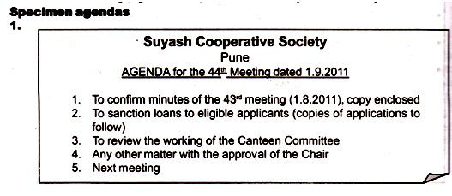
Example of an Agenda

Slide 57
Specimen of Notice with Agenda
Confidence Cement Limited
32 Motijheel Lucknow
NOTICE 1 October 2021
Notice is hereby given that the second meeting of the board of directors will be held at the registered office of the company at 3:30 p.m. on Friday October 10, 2021.
Asif Iqbal
(Secretary)

Slide 58
Agenda:
Agenda
Confirmation of the minutes of the last meeting
Matters arising from the minutes
Financial irregularities of company accountants
Confirmation of the appointment of auditor
Date of next meeting

Slide 59
Minutes
Minutes are a record of what happened in a meeting
It is a chronological written statement of decisions and resolutions taken in a meeting
Usually, they are concise and brief
The description is given in the past tense
The minutes should be approved by the participating members of the meeting and must be concluded by the signatures of the authorized person of the meeting.

Slide 60
The overall minutes should give:
1. The name of the organization/ unit
2. Day, date, time and place
3. Number in order (e.g., 33rd meeting of…)
4. Names of chairperson and secretary
5. Names of members present
6. Names of the absentees
7. Record of the transactions (on the guidelines given above)
9. Signature of the secretary and, after approval, that of the chairman.

Slide 61
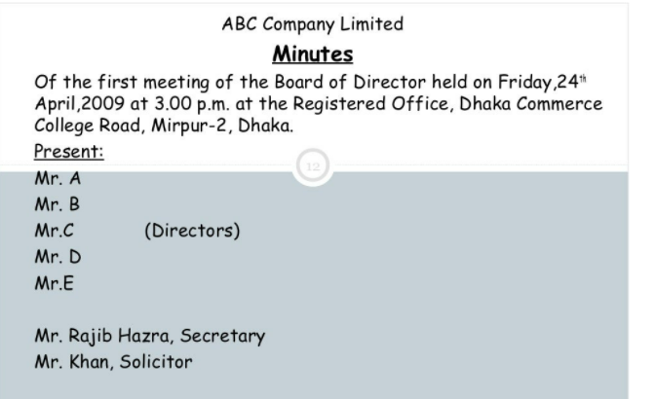
MINUTES OF THE MEETING
Example

Slide 62
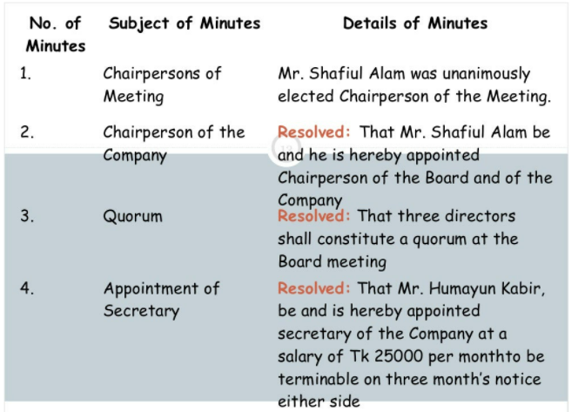
MINUTES OF THE MEETING cont…
Example

Slide 63
Daily Quiz
1. What are meeting minutes?
A list of what will be discussed or acted upon at meetings, events or conferences
Document that describe discussions, decisions and actions that happen during a meeting
None of the above
2. The agenda is prepared after the meeting has occurred.
True
False

Slide 64
Daily Quiz-Answers
1. What are meeting minutes?
A list of what will be discussed or acted upon at meetings, events or conferences
Document that describe discussions, decisions and actions that happen during a meeting
None of the above
2. The agenda is prepared after the meeting has occurred.
True
False

Slide 65
Weekly Assignment
What are the essential requirements of a meeting?
What is the difference between agenda and minutes?
Draft a notice informing the students about the cultural fest to be held in your college.

Slide 66
Topic Links
https://www.youtube.com/watch?v=gamJROG7eOw (Notice, Agenda and Minutes)
https://www.youtube.com/watch?v=aEmlvZJ9ytY (Notice, Agenda and Minutes)

Slide 67
MCQs
Meetings, if effectively managed, can become a potentially powerful tool for transforming the organisation.(True/ False)
Four Ws of a successful meeting are:
(a)Why
(b)Who
(c)Where
(d)When
(e)What
Three important aspects of meeting are _____, ____, and _____________

Slide 68
MCQ Answers
Meetings, if effectively managed, can become a potentially powerful tool for transforming the organisation. True
Four Ws of a successful meeting are why, who, where and when.
Three important aspects of meeting are notice, agenda, and minutes

Slide 69
Old Questions
Write a Notice notifying your society members about a blood donation camp organized in your society, as the society president. (2018-19)
“An agenda is the list of individual items that ensure that the meeting achieves its broad aims.” Write an agenda for a sales meeting and write the minutes of meeting as well.

Slide 70
Expected Questions
Draft a Notice for your college’s cultural festival. Invent the necessary details.
As the Director of your college conduct a meeting, apprising your colleagues of the previous meeting that was held on 1 March 2019. Here, you need to invent the details of minutes of that meeting.

Slide 71
Recap
Meetings are an important aspect of Professional communication.
Notice is the information regarding meeting sent to the participants
Three important aspects of meeting are notice, agenda, and minutes.
An agenda is the list of items to be considered at a meeting.
Minutes are a record of what happened in a meeting

Slide 72
Noida Institute of Engineering and Technology, Greater Noida
Forms of Technical Communication
AASL 0401
Unit: II
Topic 4- Job Application, CV and Resume
Department of English
B.Tech III/IV Semester

Slide 73
Topic Mapping with Course Outcome
Students will understand the correct structure and method of writing a resume/CV.
Students will be able to prepare their resume effectively and correctly for the recruitment and other official purposes.

Slide 74
Prerequisite and Recap
Recap
Notices, Agenda and Minutes
Prerequisite
Understanding of preparation of official documents

Slide 75
Topic Objective
Students will be able to understand the correct structure and method of writing a resume/CV.
Students will be able to prepare their resume effectively and correctly for the recruitment and other official purposes.

Slide 76

Job Application
A job application letter, also known as a cover letter, should be sent or uploaded with your resume when applying for jobs.
Your resume offers a history of your work experience and an outline of your skills and accomplishments, the job application letter you send to an employer explains why you are qualified for the position and should be selected for an interview.

Slide 77
What to include in a Job Application?
Heading: A letter of application should begin with both your and the employer's contact information (name, address, phone number, email) followed by the date.
Salutation: This is your polite greeting. The most common salutation is "Dear Mr./Ms." followed by the person's last name.
Body of the letter: Think of this section as being three distinct parts.
In the first paragraph, you'll want to mention the job you are applying for and where you saw the job listing.
The next paragraph(s) are the most important part of your letter. Remember how you gathered all that information about what employers were seeking, and how you could meet their needs? This is where you'll share those relevant details on your experience and accomplishments.
The third and last part of the body of the letter will be your thank you to the employer; you can also offer follow-up information.
Complimentary Close: Sign off your email with a polite close, such as "Best" or "Sincerely," followed by your name.
Signature: When you're sending or uploading a printed letter, end with your signature, handwritten, followed by your typed name. If this is an email, simply include your typed name, followed by your contact information.

Slide 78
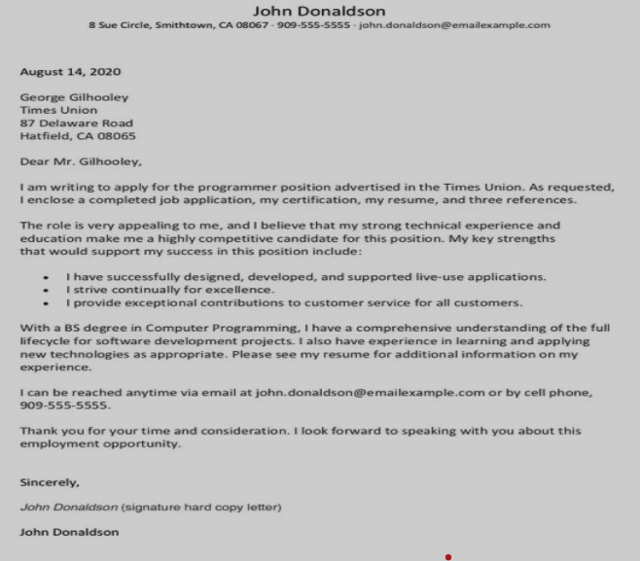
Job Application Sample

Slide 79
CV and Résumé Writing
What is it?
A well written, well produced, appropriate CV/curriculum vitae (British English) or résumé (American English) is vital for getting you to the interview stage for a job.
A resume is a one page summary of your work experience and background relevant to the job you are applying to. A CV is a longer academic diary that includes all your experience, certificates, and publications.

Slide 80
CV v/s Résumé
CV and Résumé Writing
CV
Résumé
CV (Curriculum Vitae, which means course of life in Latin) contains a high level of detail about your achievements, a great deal more than just a career biography
A CV presents a full history of your academic credentials, so the length of the document is variable
Résumé is a French word meaning "summary", signifies a summary of one's employment, education, and other skills, used in applying for a new position
A resume presents a concise picture of your skills and qualification, so length tends to be shorter.

Slide 81
Contd..
CV and Résumé Writing
CV
Résumé
In Europe, the Middle East, Africa and Asia, employers expect a CV. In the U.S., a CV is used primarily when applying for academic, education, scientific or research
Two pages or a little more
Job
(All kinds)
One page, sometimes two pages

Slide 82
CV and Résumé Writing
TYPES
FUNCTIONAL
CHRONOLOGICAL

Slide 83
FORMATS
CV and Résumé Writing
Reverse Chronological
Functional or Skills-Based
Emphasizes work
experience history around dates
Highlights career progression
Is what employers prefer
Organizes information around functional headings which highlight skills & abilities

Slide 84
Contd..
CV and Résumé Writing
Reverse Chronological
Functional or Skills-Based
Advantages:
Easier to understand
your job history
Helps the name of a previous employer stand Out
Typically used when you are staying in the same field
Disadvantages:
Much more difficult to highlight what you do best
Advantages:
It will assist you in achieving a new goal or direction
Skills stand out
Disadvantages:
Hard for employer to know exactly what you did in which job which could be a problem for conservative readers
Past companies are not prominent

Slide 85
CV and Résumé Writing
Style & Appearance
Stick to 10-12 font size
Times New Roman and Arial are standard fonts
Use bold/italics/CAPS/underlining for highlighting
Use lines to separate heading/sections
Use bulleted statements with action-oriented verbs
½”-1” margins all 4 sides
Balance white space and text

Slide 86
CV and Résumé Writing
Contd.
Use white or light-colored paper
Use same style paper for resume/CV, cover letter and references

Slide 87
CV and Résumé Writing
Writing Tips
Spend ample time preparing your resume/CV
Be prepared to write and rewrite
One-page resume is usually sufficient, CV’s are two or more pages
Customize your resume/CV for each position
Catch your reader’s eye
Accentuate the positive
Use action-oriented verbs and quantify when possible

Slide 88
CV and Résumé Writing
Writing Tips (Cont.)
Remember the three C’s
Clarity: make presentation clear and concise
Consistency: do not mix categories and dates
Conciseness: summarize and highlight

Slide 89
CV and Résumé Writing
Résumé Content Heading
Cap the top of your resume with:
Full name
Complete postal address
Phone number
E-mail address

Slide 90
CV and Résumé Writing
The Basics of Résumé Content
Categories used will vary based on your qualifications and/or intended goal
indicate skills developed/demonstrated
indicate value added – accomplishments

Slide 91
EXAMPLE HEADINGS
CV and Résumé Writing
Good
Bad
Cecilia X. Sample
222 Strawberry Lane
Columbia, South Carolina
29208803.777.3972
c.xsample@mailbox.sc.edu
Cecilia X. Sample
222 Strawberry Lane
Cola, S.C.
29208 803.777.3972
rambocecil@mailbox.sc.ed
Cola, S.C.
29208 803.777.3972
rambocec@mailbox.sc.edu

Slide 92
CV and Résumé Writing
OBJECTIVE
The objective is an optional category that indicates the type of work you are seeking.
Employers prefer objectives that are specific and concise.
If you know the exact position you are pursuing or field that you are considering, you may include an objective.

Slide 93
Example Objectives
CV and Résumé Writing
Good
Bad
OBJECTIVE
An internship at Computer Sciences Corporation in computer programming.
OR
A management training position at Bank of America
OBJECTIVE
An internship utilizing my skills and training.

Slide 94
CV and Résumé Writing
EDUCATION
Degrees should be listed in reverse chronology Include only those schools in which you earned a degree
Names and locations of schools or programs
Graduation date
Degrees or certificates
Major or minor
Grade point average
Awards/Honors/Scholarships (consider a separate section if more than 3)
Study abroad experiences

Slide 95
CV and Résumé Writing
Related Coursework
This category is optional and can also be part of the Education section
Mainly used when you are lacking related experience but want to demonstrate specific knowledge
List the titles of courses you’ve taken that relate to the position for which you are applying

Slide 96
CV and Résumé Writing
Experience
Include full-time and part-time jobs, summer positions, volunteer work, military service, internships, self-employment, research projects, and even activities if they are directly related to the position
In some cases, you may wish to divide this category into two sections: one called Related Experience and one called Additional Experience

Slide 97
CV and Résumé Writing
Additional Categories
HONOURS, ACTIVITIES, RESEARCH, PROFESSIONAL AFFILIATIONS
-You may specifically want to list:
Activities or leadership positions that demonstrate job related skills
Honors or awards (Scholarships may or may not be relevant)

Slide 98
CV and Résumé Writing
Additional Categories Contd..
SKILLS
We recommend a separate section listing computer skills. Be specific, listing product names and version numbers if possible
Students seeking technology positions specifically should break this list down into subcategories such as programming languages, hardware, software, operating systems, databases, peripherals, etc.
For Example-
Computer
• Languages: C++, java, HTML, CSS
• Applications: Microsoft Office, Eclipse
MATHLAB
• Machines: Unix, Linux, Solaris

Slide 99
CV and Résumé Writing
Additional Categories Contd..
If you speak more than one language, you should also list them here, indicating your level of proficiency in each
For Example-
Languages
• Fluent in French and Spanish and basic knowledge of German

Slide 100
CV and Résumé Writing
Additional Categories Contd..
Hobbies:
Extra- curricular/ Co- curricular activities
Leisure time activities
References
Personal Details

Slide 101
CV and Résumé Writing
Final Tips
Employers only look at a resume for 10 -20 seconds, make sure they get what you want them to from that glance!
Always include a cover letter when mailing out your resume
Use a paper clip, do not staple your cover letter to your resume

Slide 102
Faculty Video Links, YouTube & NPTEL Video Links and Online Courses Details
https://www.youtube.com/watch?v=jETH9SI2zNQ
https://www.youtube.com/watch?v=PAthQKLhBTs
https://www.youtube.com/watch?v=Tt08KmFfIYQ (Resume)
https://www.youtube.com/watch?v=UP-S9rvAYYo (Resume)

Slide 103
Daily Quiz
1. Resume is a _____ word. a) French b) German c) Indian d) American
2. Curriculum vitae is a ____ word. a) French b) German c) Latin d) Indian
3. References are mentioned in a resume. a) True b) False
4. Which of the following resume components is where you should state your career goal?
a) Profile b) Objective c) Summary
5. Which of the following should NOT be part of a resume?
a) Religious affiliation b) Employment history
c) Contact information d) Education

Slide 104
Daily Quiz Answers
1. Resume is a _____ word. a) French b) German c) Indian d) American
2. Curriculum vitae is a ____ word. a) French b) German c) Latin d) Indian
3. References are mentioned in a resume. a) True b) False
4. Which of the following resume components is where you should state your career goal?
a) Profile b) Objective c) Summary
5. Which of the following should NOT be part of a resume?
a) Religious affiliation b) Employment history
c) Contact information d) Education

Slide 105
MCQ s
1. Résumé includes:
a) personal details b) academic achievements
c) an account of skills d) all the above
2. Job application contains two parts
a. Chronological and reverse chronological b. CV and Résumé
c. Functional and chronological d. Résumé and cover letter
3. Which of the following is NOT a resume format?
a. Chronological b. Portfolio c. Functional d. Combination

Slide 106
MCQ s Answers
1. Résumé includes:
a) personal details b) academic achievements
c) an account of skills d) all the above
2. Job application contains two parts
a. Chronological and reverse chronological b. CV and Résumé
c. Functional and chronological d. Résumé and cover letter
3. Which of the following is NOT a resume format?
a. Chronological b. Portfolio c. Functional d. Combination

Slide 107
Weekly Assignment
You have seen an advertisement in an English newspaper for a job in Tata Consultancy… New Delhi. You decide to apply for the job. Write a letter to the Manager, HR of the company. In your letter:
introduce yourself
explain what experience and special skills you have
explain why you are interested in the job

Slide 108
Old Question Papers
What are the salient features of a resume? Write a short resume for the post of technical executive in TCS in Delhi. Invent necessary details to write a compact and impressive professional CV.(2017-18)
Resume is the stepping stone to enter in the professional world. Make your own resume including all the necessary details of your achievements.(2016-17,2017-18)
Write a job application for the post of Manager, Advertising Section, Image and Vision, New Delhi. Enclose your Resume. (2015-16 )
“An Agenda is the list of individual items that ensure that the meeting achieves its broad aims”. Write an agenda for a sales meeting and write the minutes of the meeting as well.(2018-19)

Slide 109
Expected Questions for University Exam
Prepare the Résumé of a candidate applying for the post of Manager, Publications Division, penguin India Ltd.
You are Mahesh Chand. You want to apply for the post of a Marketing Manager in a reputed MNC. Apply for the same along with your resume.

Slide 110
Recap of Unit
Qualities associated with Technical Writing
Characteristics of Technical Writing
Technical vocabulary
Etymology of Technical words
Letter is a hard copy, and the e-mail is a soft copy – an electronic message.
The commonly used format for business letters and e-mails is Block format.
Various expressions usage in Business letters and e-mails.
Notice is the information regarding meeting sent to the participants
Three important aspects of meeting are notice, agenda, and minutes.
An agenda is the list of items to be considered at a meeting.
Minutes are a record of what happened in a meeting

Slide 111
THANK YOU

